Slide 1
Disclaimer and Use
***Information shared in these slides are the opinions of the contributors, and not best evidence.
Information contained in this resource is available for free use and sharing. Areas that can be adapted to your organizational or local context
No part of this training should be made available for profit.
Information in this training is meant to provide general information on disability-inclusive employment practices and must be implemented with consideration of the context in which it is delivered.
Delete this slide once you have prepared the slide deck for your organization.
– Delete this slide before presenting –
Notes:
Delete this slide before presenting.
Include this slide if sending out a slide deck.

Slide 2
How to use this presentation
Note that the slide deck is not guaranteed “remediated for accessibility” after being edited
Please feel free to add these lived experience examples to your own presentation to amplify the messages.
– Delete this slide before presenting –
Notes:
Delete this slide before presenting.

Slide 3
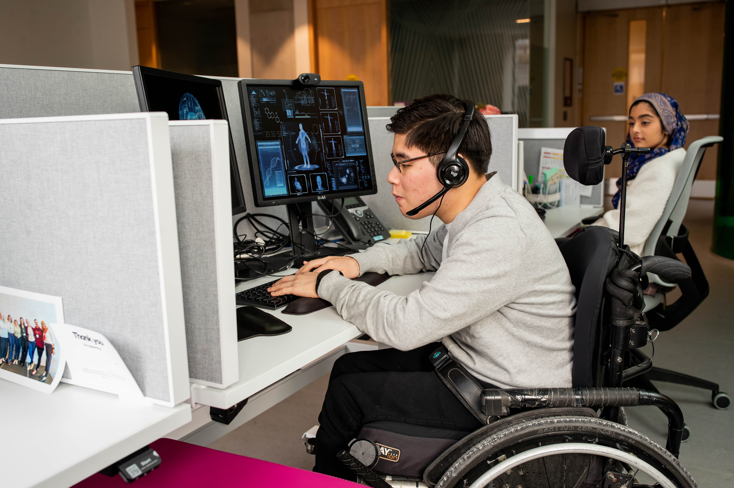
Inspire, hire, train, retain
[Organization to insert own Logo]
Preparing healthcare people-leaders to support disability-inclusive employment practices through hiring, engaging, and retaining employees with disabilities
Notes:
Add your logo, welcome group to the space

Slide 4












IHTR was co-designed by these organizations:
Project team contributors:
Champion organizations:
Contributing organizations:
Empowered Kids Ontario, Kids Health Alliance, Centre for Addiction and Mental Health, Unity Health, ErinOak Kids, Pathways Sarnia, The Institute for Work and Health, University Health Network
Notes:
Other notes:
Please acknowledge the project contributors with a statement such as the following:
“We would like to acknowledge the organizations that contributed to the creation of this training.” You do not need to name all organizations.

Slide 5


Funding provided by
The views expressed in this presentation are those of the co-design organizations and do not necessarily reflect the views of the Province.
Notes:
Other notes:
Please acknowledge the Government of Ontario with the following statement: “Funding for the creation of this training was provided by the Government of Ontario and donors to the Holland Bloorview Kids Rehabilitation Hospital Foundation.”

Slide 6
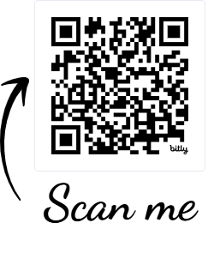
To access our materials visit:
https://hollandbloorview.ca/IHTR

Slide 7
Additional content
The following slides provide additional lived experience examples and videos that may fit better with your organization’s delivery of the IHTR material.
Feel free to add these into your delivery throughout the presentation.

Slide 8
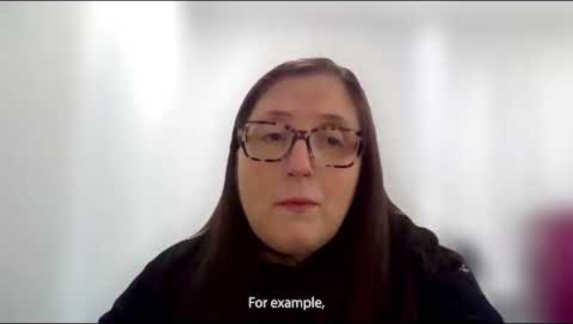

Gabriella
Gabriella works at a rehabilitation organization and has a visible disability
Notes:
Gabriella shares about the importance of hiring, retention, and inclucion.
Gabriella also has a video available in our library on the IHTR website: https://www.youtube.com/watch?v=gSGQrAtNqdg

Slide 9
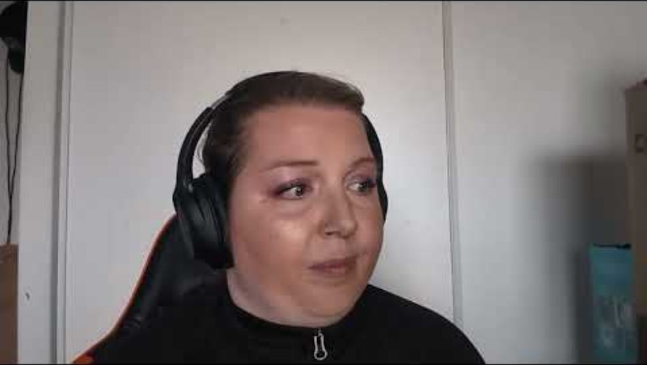
Karina
Karina works at a rehabilitation organization and has an invisible disability
Notes:
Karina shares about the importance of accommodation, return to work, and privacy
Karina also has a video available in our library on the IHTR website: https://youtu.be/Vq4kr5McuKU

Slide 10
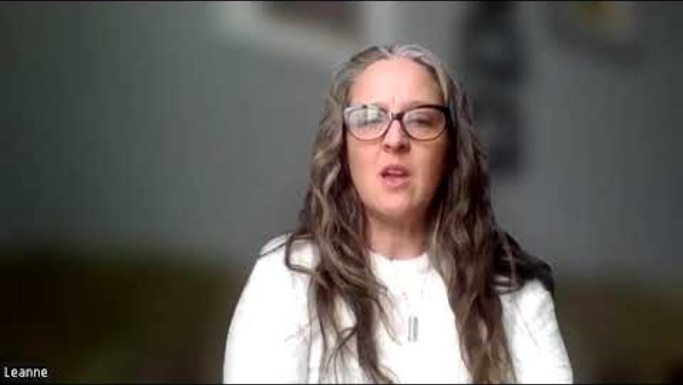
Leanne
Leanne works at a rehabilitation organization and has an invisible disability
Notes:
Leanne shares about the chronic nature of return to work after physical and mental health injuries
Leanne also has a video available in our library on the IHTR website: https://youtu.be/R46ae8F0jDU

Slide 11
Julia
One thing healthcare organizations are doing well to support diverse and disability inclusive workforces is offering more accessibility through flexible schedules, virtual work options, and being open to making facilities and equipment that are physically accessible. These also have the great side-benefit of making spaces and services accessible for the patients too!
One suggestion to increase accessibility and employment inclusion in healthcare is to adapt training and reference materials (such as organizational policies) to be accessible in multiple formats.
This will also increase the general staff knowledge on
how to make accessible work materials with existing
software features.
Julia works in a rehabilitation organization and has visible
and invisible disabilities
Notes:
Julia talks about accommodations and universal accessibility.

Slide 12
Lee
One thing healthcare organizations are doing well to support diverse and disability inclusive workforces is providing onsite physiotherapy and access to ergonomic assessments.
One suggestion to increase accessibility and employment inclusion in healthcare is understand that staff do not ask to get injured on the job. When they do, organizations and management need to show compassion and understanding.
Lee works in a community health organization and has an invisible disability
Notes:
Lee talks about injury on the job.

Slide 13
Chloe
One thing healthcare organizations are doing well to support diverse and disability inclusive workforces is encouraging teamwork and collaboration with persons with disabilities.
One suggestion to increase accessibility and employment inclusion in healthcare is to decrease stigma with the word “disability” and to encourage other workers to be open and ask questions to persons of disabilities to encourage clear communications and expectations-especially for those with invisible disabilities.
Chloe volunteers at a rehabilitation organization and has an
invisible disability
Notes:
Chloe shares about the importance of reducing stigma and opening clear communication with colleagues about disability.

Slide 14
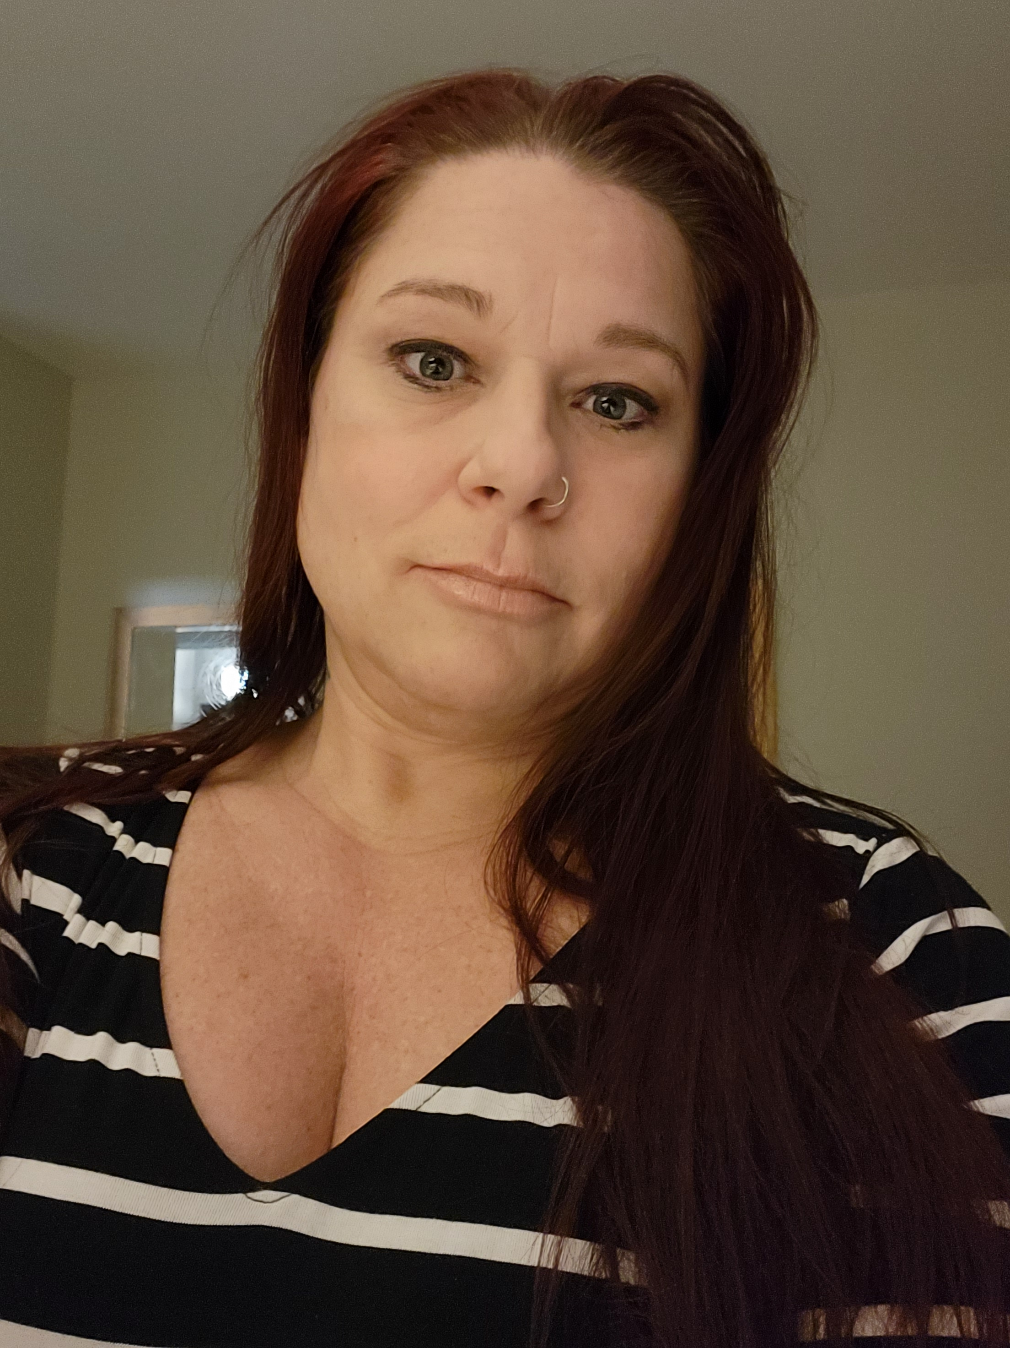
Stephanie
One thing healthcare organizations are doing well to support diverse and disability inclusive workforces is physical accessibility such as accessible parking and automatic doors.
One suggestion to increase accessibility and employment inclusion in healthcare is to seek more input from employees regarding the resources and equipment that would help do their jobs better.
Stephanie works at a mental health hospital and has an invisible disability
Notes:
Stephanie shares about the need to seek employee’s own inputs on their needs.

Slide 15
Maggie
One thing healthcare organizations are doing well to support diverse and disability inclusive workforces is beginning to acknowledge that there are many different forms of disabilities.
One suggestion to increase accessibility and employment inclusion
in healthcare is to have more education and awareness that not all disabilities are visible or fit into the "cookie cutter" norm.
Maggie works in an acute care hospital and has visible and
invisible disabilities
Notes:
Maggie talks about the diversity of disabilities and the need to recognize that each person is unique

Slide 16
Shawna
One thing healthcare organizations are doing well to support diverse and disability inclusive workforces is partnering with job placement agencies to employ young individuals with intellectual disabilities. These collaborations provide meaningful employment and promote an inclusive environment where all employees can thrive, contributing to a stronger, more diverse workforce.
One suggestion to increase accessibility and employment inclusion in healthcare is to implement targeted training programs for hiring managers
and staff on disability awareness and inclusive practices. This would
help create a more welcoming environment for individuals with
disabilities, ensure fair hiring processes, and provide support
for employees with diverse needs, ultimately fostering a
more inclusive healthcare workforce.
Shawna works in an acute care hospital and has an invisible disability
Notes:
Shawna talks about the importance of support for recruitment, hiring, and onboarding.

Slide 17
Eric-1
One thing healthcare organizations are doing well to support diverse and disability inclusive workforces is having physical accessibility features such as ramps, reserved parking for disabled people, and spaces within the hospital setting to accommodate wheelchairs. This benefits staff and patients alike.
One suggestion to increase accessibility and employment inclusion in healthcare is to be inclusive of your team in different ways, for example, by simply taking the elevator when in a group, and do not assume everyone can take the stairs just because they appear to walk easily. Asking "does anyone not want to take the stairs?" puts people on the spot and no one wants to be the barrier to others taking the 'healthy' option.
The aim needs to be psychological safety. I want to feel comfortable
sharing, to feel that I won't be singled out when I speak up. I want to
feel accommodated without feeling like I'm being treated special.
Eric works at a rehabilitation organization and has an invisible disability
Notes:
Eric shares about the role of social inclusion in team collaboration and psychological safety for all staff

Slide 18
Cindy
One thing healthcare organizations are doing well to support diverse and disability inclusive workforces is providing staff with the equipment they need to fulfil their responsibilities.
One suggestion to increase accessibility and employment inclusion in healthcare is that all levels of the workplace need to be trained in the Ontario rights for persons with disabilities legislation. For example, sometimes I have needed to educate our IT department about my right to have different computer equipment from my peers so that I can participate in the workforce.
I would also like to share how valuable it is for me to be able to
participate in my career.
Cindy works at a community health organization and has an invisible disability
Notes:
Cindy shares about the importance and rights surrounding accommodation.

Slide 19
Yaroslav
One thing healthcare organizations are doing well to support diverse and disability inclusive workforces is making sure that there is more diversity and more opportunities for minorities in Canada to work and be more included in the healthcare. Also healthcare organizations have been improving in overall knowledge on invisible disabilities. For example having more resources for substance abuse and being able to treat it better.
One suggestion to increase accessibility and employment inclusion in healthcare
is to train more professionals about mental health and how to communicate
with patients and colleagues who are neurodivergent. If this is done more,
doctors such as physicians will have a better time understanding their
patient and making the patient more comfortable in a situation
where they might feel anxious and overwhelmed due to the
circumstance they are in. Same with supervisors and staff or
volunteers
Yaroslav volunteers at a rehabilitation hospital and has an invisible disability
Notes:
Yaroslav shares about the benefits of representation in the workplace

Slide 20
Karina
One thing healthcare organizations are doing well to support diverse and disability inclusive workforces is training leaders on how to engage with individuals who have disabilities – such as time off, sick time, accommodations.
One suggestion to increase accessibility and employment inclusion in healthcare is to reconsider the access that HR has to Occupational Health status of accommodation or return to work plans. I have been trying to get a new job that is permanent full time so that I am allowed paid sick days, but HR has access to my sick time related to my mental health, and this limits me from getting access to employment within the organization. This represents a discriminatory practice that should be dissolved.
I would also like to share that organizations continue to have many structural barriers in
place with hiring and retention that discriminate against employees returning to work
for physical injury and mental health conditions that result in missed work. These
are subtle and can only be seen by those who work for an organization and see
the policies in place. These types of discrimination are structurally built into
policy regarding HR recruitment internally and need to be irradicated.
Karina works at a rehabilitation organization and has an invisible disability
Notes:
Karina shares about the importance of accommodation, return to work, and privacy
Karina also has a video available in our library on the IHTR website: https://youtu.be/Vq4kr5McuKU

Slide 21
Leanne
One thing healthcare organizations are doing well to support diverse and disability inclusive workforces is providing full pay while staff are on short-term disability leave.
One suggestion to increase accessibility and employment inclusion in healthcare is more flexibility with the number of hours and days required when attempting return to work. We need more awareness that not all disabilities are acute; chronic problems take longer than 6 weeks for recovery.
I would also like to share that the return-to-work practices are very
focused on acute conditions. My experience was that the program needs
did not match with mine.
Leanne works at a rehabilitation organization and has an invisible disability
Notes:
Leanne shares about the chronic nature of return to work after physical and mental health injuries
Leanne also has a video available in our library on the IHTR website: https://youtu.be/R46ae8F0jDU

Slide 22
Ellen
One thing healthcare organizations are doing well to support diverse and disability inclusive workforces is encouraging training and development for employees with disabilities and creating more opportunities in the workforce. They are also working to educate staff about working with their coworkers with disabilities.
One suggestion to increase accessibility and employment inclusion in healthcare is the major barriers faced by employees with disabilities to getting employment. It would be better if we can create and employ those people with disability who still wanted to work, achieving equity.
Ellen works at a hospital laboratory department and has an invisible disability
Notes:
Ellen shares about equity and how create environments that support a more inclusive workforce for employees with disabilities.
Ellen also has a video available in our library on the IHTR website

Slide 23
Lived perspectives-
One thing healthcare organizations are doing well to support diverse and disability inclusive workforces is specifically adding neurodiversity to the accessibility policy.
One suggestion to increase accessibility and employment inclusion in healthcare is a more neurodiverse approach to training. As someone with ADHD, training sessions on topics such as time management and organizational skills are ineffective for me. They cater (unconsciously?)
to a neurotypical audience. It would be great if there are separate
courses for this training. In particular, when this training is required,
it’s not a great use of my time to attend as it feels irrelevant.
This employee works in an acute care hospital and has an
invisible disability
Notes:
This anonymous employee shares about experiences of neurodiversity and ADHD in neurotypically-aligned trainings.

Slide 24
Lived perspectives-4
One thing healthcare organizations are doing well to support diverse and disability inclusive workforces is providing accommodation to staff who are still able to work but have limitations.
One suggestion to increase accessibility and employment inclusion in healthcare is to create more positions aimed at supporting health care workers who have disabilities. Not every nurse can work bedside care in totality but still enjoy parts of patient care, these staff often get left out of patient care due to their limitations, but their knowledge and skills can still be utilized.
Staff should not feel trapped in their position because of their
limitations. Safe staffing ratios can support these employees
in continuing their hands on care in a safe manner.
This employee works in an acute care hospital and has an
invisible disability
Notes:
This anonymous employee shares about the potential for the skills of employees who have expertise but cannot complete all aspects of a job.

Slide 25
Lived perspectives-5
One thing healthcare organizations are doing well to support diverse and disability inclusive workforces is offering different jobs for staff who need them.
One suggestion to increase accessibility and employment inclusion in healthcare is to reduce quick judgements of staff with disabilities.
I was quickly judged that I could not do my job.
This employee works in a detox centre and has a visible disability
Notes:
This anonymous employee shares about the negative experience of stigma and quick judgement.

Slide 26
Lived perspectives-6
One thing healthcare organizations are doing well to support third-party and disability inclusive workforces is advertising themselves as inclusive.
One suggestion to increase accessibility and employment inclusion in healthcare is being more flexible to providing accommodations instead of forcing short-term disability/long-term disability leaves of absence.
Having to deal with a third-party disability management group is
frustrating and undignifying. You have to answer invasive personal
health questions and provide private medical information to
someone who is not a part of your circle of care just to prove
that your illness or need for accommodation is legitimate.
This employee works in an acute care hospital and has an
invisible disability
Notes:
This anonymous employee shares about the supporting dignity in the disability-request process.

