Slide 1
Project SEARCH Ontario programs are welcome to use slides from this template deck.
Please download and edit as you wish according to your audience.

Slide 2



Deck developed by:
Remove system barriers to expand access & impact:
Project SEARCH transition to work model for Ontario youth with disabilities
2025-January

Slide 3
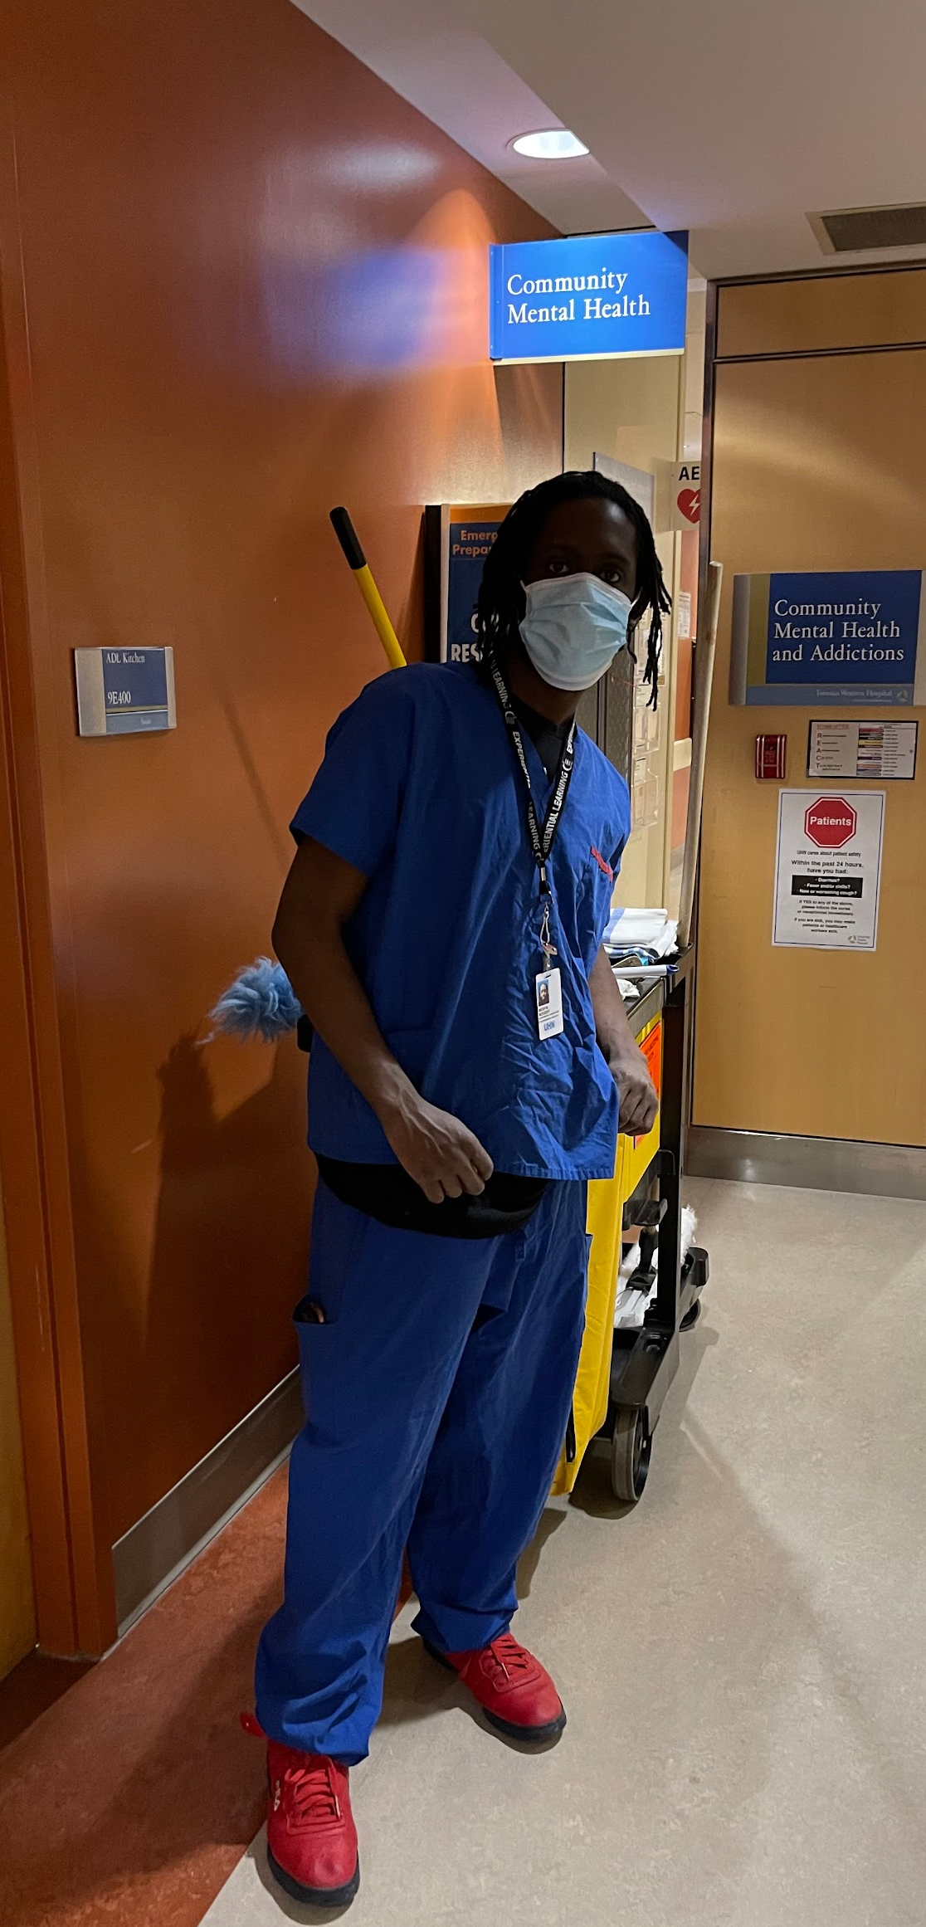
Agenda

Slide 4
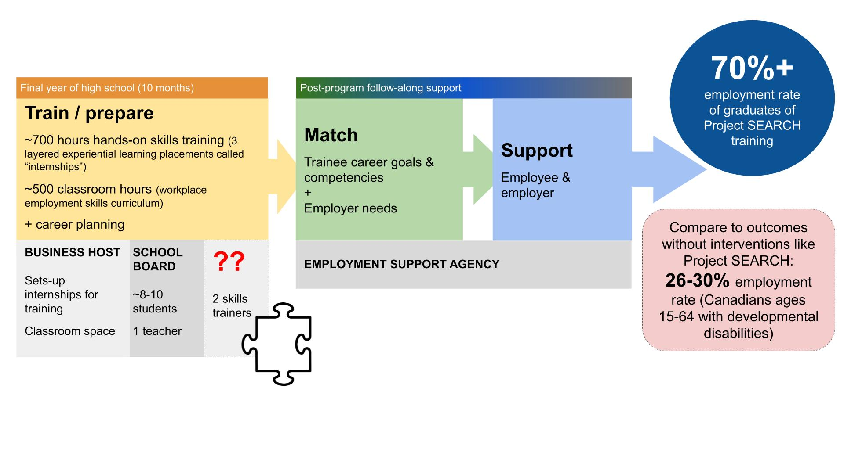
Evidence-based, effective model
Systemic barrier & missing piece: Funding for the skills trainer position as a disability support during the training year
Local programs currently scramble to fund this critical resource through a combination of short-term grants and donations
Notes:
The Project SEARCH program in Ontario operates during a final year of high school. Students remain enrolled with their school board but they are fully immersed at a host business. A typical day includes ~ 90 minutes of classroom based employability skills training and ~ 240 minutes of hands-on work experience in an experiential learning placement (called an “internship”). Several weeks a year are spent fully in class for orientation and integration activities between the internships. This adds up over the school year to ~ 500 classroom hours and ~ 700 work experience hours. Each student with their family/circle of support participates in 6 personalized employment/career planning meetings over the 10 months. Each student does 3 internships over the year and these are intentionally connected to layer transferable job-specific and employability skills acquisition so students graduate with skills in demand in the local labour market.
There is 1 teacher for a typical cohort size of 10 students and 2 skills trainers. This staff ratio enables continuous skill development, feedback and personalized progress toward realistic employment goals.
As students graduate they receive typical employment support services. Ideally these employment support services are engaged before the end of the training year so there is a smooth transition. Project SEARCH programs worldwide consistently have employment outcomes of 70% or higher. This is 2.5x higher than typical employment outcomes for Canadian adults with disabilities (at 26%).
There is no consistent mechanism currently in Ontario to fund the essential skills trainer resource. Local Project SEARCH sites are at risk of not being able to continue to operate effectively or at all. Those that continue write annual grant applications and often fund the skills trainer role through combinations of 3+ funding sources (a large administrative burden). This lack of clarity about how to sustainably fund a program is limiting expansion of the model in existing communities and to new communities across Ontario. This is an access issue for Ontario youth with disabilities. This is the core of what we want to discuss today, but first let us give you a bit more information on Project SEARCH.
References:
-Project SEARCH model and outcomes www.projectsearch.us
-For comparison statistic (26%) Berrigan, Scott & Zwicker (2020), Journal of Autism and Developmental Disorders from 2017 Canadian Survey on Disability (Statistics Canada)

Slide 5
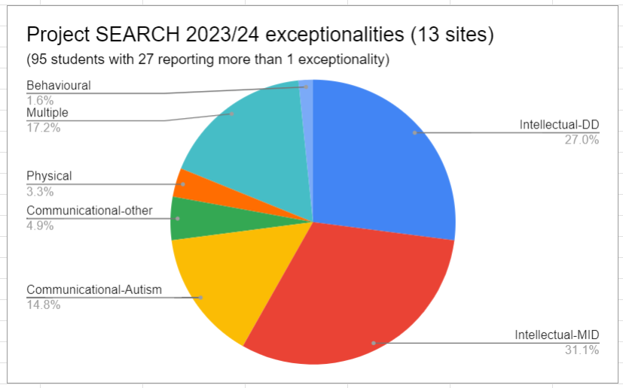
Model serves students with significant disabilities
In high school
Typically in workplace pathway/special education stream (not going to college or university)
Not yet “employment ready”; not yet able to be connected with MLITSD employment supports - need intensive pre-employment program that integrates employability curriculum, skills training/coaching, work experience and employment planning
Part of the “26-30%” without Project SEARCH
Notes:
Project SEARCH serves students with significant disabilities - enabling employment experience and training while they are still in high school.
Students are typically in the special education stream and not going on to college or university.
In Ontario in 2023/24, exceptionalities reported by the participating school boards included (95 students with 27 reporting more than 1 exceptionality): developmental disability 27%, mild intellectual disability 31%, communication-autism 15%, communication-other 5%, physical 3%, multiple 17%, behavioural 2%).
Without Project SEARCH many of these students would finish high school without a diploma or skills for employment, and be on waitlist for DSO employment supports - have more intensive needs for training/coaching/support than can be effectively addressed in the EO system. They need an intensive pre-employment program that integrates an employability curriculum, skills training/coaching, work experience and employment planning.

Slide 6
Individual impact story
Individual’s support needs at start (barriers to employment)
Highlights of support/intervention provided (actions taken)
(what, when, why, where, how, how much)
Impact-individual/family
(including employment quality indicators, health/wellbeing indicators, family impacts)
Impact-employer/community
Notes:
INSERT story (see example next slide)

Slide 7
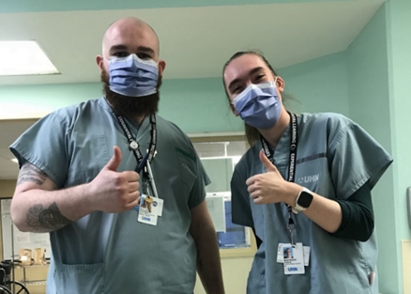
Mackenzie’s training & results
Hired - UHN patient porter
Part of union
Living wage
Pension
Likes helping people
Barriers: Reading, writing, focus, managing anxious feelings, independence
Internship & tasks | Hospital’s daycare - serving lunch, cleaning linens & equipment | Hospital’s school - sanitizing equipment, pushing patients to activities, preparing activities | Hospital’s patient transport department
Technical skills | Following detailed safety procedures, portioning and serving food, setting and cleaning tables | Sanitizing medical equipment Patient portering (small environment) | Wayfinding Safe patient transfer/transportation including with oxygen
Work life skills | Handling anxious feelings Maintaining focus on own work/routines despite environmental distraction | Following independent daily schedule Communicating with team members | Customer service and managing challenging interactions
Notes:
Mackenzie’s story illustrates how the Project SEARCH model’s unique combination of employability skills teaching and hands-on work experience internships leads to great outcomes. Mackenzie’s story is available at https://projectsearchtoronto.ca/project-search-graduate-lands-job-as-a-porter-at-princess-margaret-hospital-university-health-network-uhn/
Mackenzie’s first internship was at the hospital’s onsite daycare. She served lunch to the children, maintained linens and sanitized equipment (toys, furniture) and supported the teachers. She learned technical skills such as following detailed safety procedures for sterilizing equipment and furniture and linens, setting up lunch and portioning food. She worked on employability skills such as handling anxious feelings and stress, and also maintaining a focus on her own work and routines despite noise and visual distractions around her.
Mackenzie’s second placement was at the hospital’s school. She sanitized students’ mobility equipment and learned to push students’ wheelchairs and helped with classroom activities. She advanced her employability skills of following an independent daily schedule and communicating with team members.
In her 3rd placement, Mackenzie was placed in a patient transporter role. In terms of job-specific skills, she needed to learn to find her way around several large buildings, how to safety transfer patients (e.g., from bed to wheelchair) and how to move wheelchairs and stretchers around the building. She also had to what to do when patients are on oxygen. She also gained advanced customer service skills as patients’ communications are often affected by their illness, by stress and other factors.
Mackenzie was hired as a porter after her training with Project SEARCH. She now works an average of 25+ hours a week. She is part of the hospital union and earns a living wage (well above minimum wage) and contributes to a hospital pension. Project SEARCH not only achieves consistently high employment rates for its graduates but also in better quality jobs than would be possible without the training.
The photo shows Mackenzie (right) in hospital scrubs with her skills trainer Declan (left) also in scrubs.

Slide 8
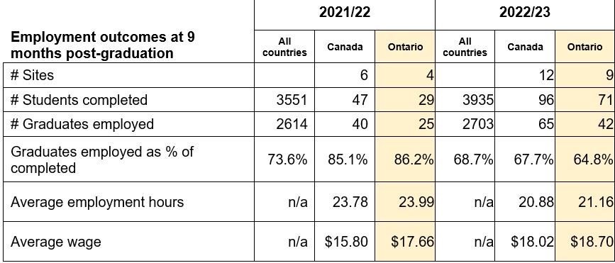
Outcome evidence - rates, hours and wages
Notes:
Project SEARCH publishes its outcome information annually. Pre and post pandemic, the overall employment rate is consistently around 70%.. This chart shows 2021/22 and 2022/23 data (the last year available as data is collected 9 months post-graduation). You can see Ontario outperformed the international average in 2021/22 (86% ON compared to 74% international). Results are down overall in 2022/23 for the first time in years due to a large expansion in the UK (US results are similar to prior years) and in 2022/23 we see a sharp dip in Ontario results now at 65% which is concerning and reflects challenges that are starting to emerge in resourcing our sites appropriately.
Note 2022/23 data: 23% of interns graduated from international programs (outside US, majority DFN UK) - the US data for 2022/23 showed rates similar to past years.

Slide 9



Impact
Transforming lives
Boost employment outcomes by 2.5x or 169%
&
Income
Social inclusion
Health & wellbeing
Building disability confidence & inclusive workplaces
Societal cost benefit
Decrease individual lifetime social assistance costs by $125-$295K per person or > $1.5M per cohort
Diverse labour force
Notes:
Project SEARCH transforms lives - boosting employment rates by 2.5x over the Canadian national average. Employment is a social determinant of health linked also to income and social inclusion. It is part of overall health and wellbeing.
There are community and societal impacts as well. Engagement in Project SEARCH builds disability confidence and a culture of inclusion at host business sites and overtime engages other organizations in the community as well.
There is a net benefit to society - investing just $16,000 per student during high school (to attend Project SEARCH) can reduce lifetime social assistance costs by $125-$295,000. For a single cohort of ~ 90 students (as in Ontario in 2023/24) this savings balloons to $1.4 million. This would grow if Project SEARCH was accessible in more Ontario communities.[this is based on calculations of savings due to tax contributions and reductions in disability income support payments]
Increased employment of persons with disabilities in Ontario will further strengthen our diverse and inclusive labour force.
Project SEARCH could be - and should be - in every Ontario community of 30,000 people or more.
References:
¹Berrigan, Scott & Zwicker (2020), Journal of Autism and Developmental Disorders from 2017 Canadian Survey on Disability (Statistics Canada)
²www.projectsearch.us/outcome-summary/
³Bowman, L.R., McDougall, C., Doucet, R., Pooran, B., Xu, Y. & Campbell, J. Funding Employment Inclusion for Ontario Youth with Disabilities: A Theoretical Cost-Benefit Model. (2024) Frontiers in Sociology (9, 10-Apr-2024)

Slide 10

Project SEARCH Ontario growth
LEGEND:
Sites in white text opened due to 2021+ Ministry of Education pilot
Site at healthcare organization
*Site closed
11
Hamilton#2
Brantford
Kitchener
London
Sudbury
Thunder Bay*
Vaughan*
19
Cambridge
Guelph (UGDSB)
Guelph (WCDSB & UGDSB)
Sarnia
Sudbury#2
Hamilton
3
Hamilton
2019/20
2020/21
2021/22
2022/23
2023/24
2024/25
2025/26
2026/27
2
Halton
Toronto
4
North Halton
?
(discussions in progress)
13
Durham
Norfolk County
Sault Ste Marie
St Catharines
Notes:
Project SEARCH started in 2019 in Ontario in Halton with early leadership from Halton Healthcare, Halton DSB and CL Oakville – and in Toronto with Holland Bloorview and UHN partnering with Toronto DSB and CL Toronto. Hamilton opened at site at the HWDSB school board office in 2020 despite the significant challenges of COVID.
The Ministry of Education recognizes the gaps for youth with special education needs and the effectiveness of the Project SEARCH model. It launched a pilot in 2021 which resulted in 6 new sites opening in 2022, 3 in 2023 and a projected 5 additional sites in 2024 so that we anticipate 19 Ontario locations in the 2024/25 school year. (All sites that started as a result of the EDU pilot are shown in white text.)
The sites currently based in healthcare organizations are shown with the blue cross beside – Hamilton’s original site also just moved this year to a healthcare location.

Slide 11
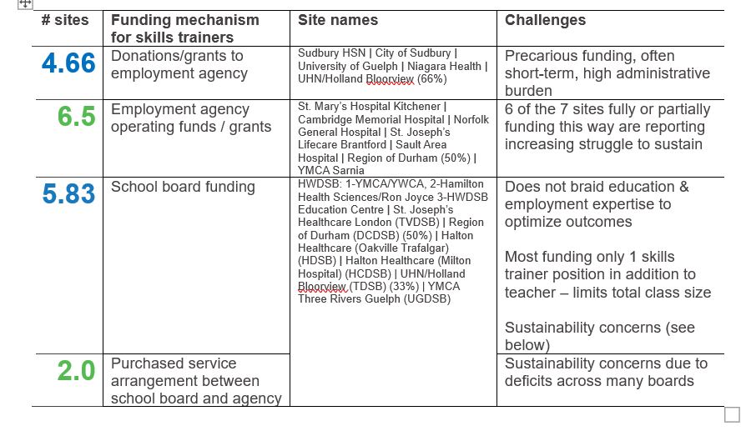
Sustainability threat - 2024/25 skills trainer funding (19 sites)
Notes:
An increasing number of Ontario’s Project SEARCH sites are reporting that funding the skills trainer may not be sustainable. Sites that primarily fund the skills trainer role through donations or grant requests face funding uncertainty which impacts staff retention and there is a high administrative burden. There are an increasing number of sites where the school board is funding all the staff roles during the training year. This does not braid in employment expertise alongside educational expertise and does not integrate the systems for smooth post-school transition to work - this is not optimizing the power of the Project SEARCH model.

Slide 12

Braided, sustainable expertise & funding needed
Youth with significant disabilities left behind in current system - inter-sectoral/agency expertise key to success
X
Current state
Education system
Employment support system
Developmental disability system
Braided expertise & funding needed for success
Employment outcome?
Education system
✔
Employment support system
Developmental disability system
Notes:
In Ontario, employment supports and developmental disability supports are delivered after a student exits the education system (see “current state” illustration in diagram).
In the US and UK, Project SEARCH is a regional workforce development strategy. Increasing access across a region typically requires alignment or “braiding” of expertise and funding - rather than new investment. [In the US skills trainers are most commonly funded through state employment supports (vocational rehab), developmental disabilities (DD) services, workforce innovation funding AND/OR a combination of one of those + education.]
This diagram shows how funding and expertise from the education, employment and developmental disability sectors should combine during the Project SEARCH training year (final year of high school) to provide an effective amount and duration of support and maximize impact
Why it’s crucial
Effective operation of existing Project SEARCH sites - base for achieving strong employment outcomes consistent with the Project SEARCH model
Enable spread – efficient start-up for new sites - increased access for students with significant disabilities across Ontario

Slide 13
Optimal resourcing for effectiveness & sustainability
Option 1 | 1 teacher | 2 skills trainers if 6+ interns | $160K
 | SCHOOL BOARD | EMPLOYMENT SERVICES | AGENCY FUNDING GAP
Option 2 | 1 teacher + 1 paraprofessional as skills trainer | 1 skills trainer if 6+ interns | ~ $80K
 | SCHOOL BOARD | EMPLOYMENT SERVICES | AGENCY FUNDING GAP
Notes:
Following from the previous slides explanation of the need for braided funding & expertise - this slide illustrates two options for an effective and sustainable Project SEARCH program/site.
Option 1: The school board funds a teacher. Two skills trainers are assigned from an local employment support provider - if appropriate/sustainable public funding stream can be identified [the current challenge]. This cost is estimated at $160,000/year (budget example available in section 2 if needed].
Option 2: If the local school board can assign 1 paraprofessional to act as 1 skills trainer - in addition to the teacher role - then the local employment service provider could assign 1 skills trainer [if appropriate/sustainable public funding can be identified - which is the current challenge.] This cost is estimated at $80,000/year.
Note - if there is a cohort size of less than 6 interns then 1 teacher + 1 skills trainer are the required resources.

Slide 14
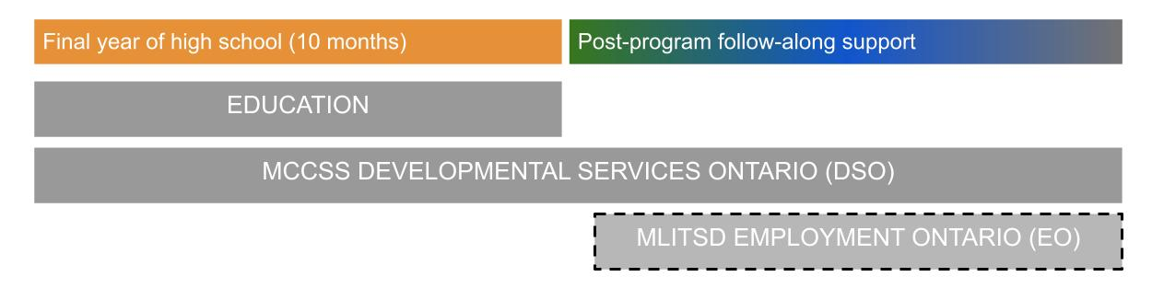
Options for sustainable funding for skills trainer role
Braid funding
Adjust policy, processes, eligibility
MCCSS Developmental Services | MLITSD | Education
Option 1: Flow DSO employment support (ES) (or community participation support) $ to approved agency on student acceptance to a Project SEARCH program so agency can fund 1 skills trainer during training year and some post-graduation transition to work (follow-along) employment support | Consider funding sources such as Skills Development Fund Consider specialized funding stream through Integrated Employment Services system Continue to fund post-graduation employment supports through Employment Ontario stream C | Share practice information that many school boards are funding: 1 teacher + 1 paraprofessional (EA/EW) to act as skills trainer (funded through combination of streams: special education, experiential learning, general student needs, student success)
Option 2: Make special one time enhanced Passport allocation on student acceptance to a Project SEARCH program which student then directs to funding their portion of the cost of a skills trainer at their Project SEARCH site. (Student’s base Passport allocation would remain available for them to direct their community participation support.)
Notes:
This slide presents options for adjusting policy, processes and/or eligibility criteria and so that expertise and funding can be braided to identify a clear, sustainable funding mechanisms for skills trainers that can be accessible across Ontario.
Multiple options are possible but if the Ontario Ministry of Education could share options with school boards for funding 1 skills trainer in addition to 1 teacher then adjustments by MCCSS could enable a mechanism for funding a second skills trainer - for example, shifting the start date for DSO funding to start during the Project SEARCH training year or make a special one time Passport funding allocation to students enrolled in Project SEARCH.
Ministry of Labour has some funding streams that have supported sites in the past - the Skills Development Fund. However, those are one time grants that must be reapplied to every year, creating instability for program planning and staffing. Could there be a solution somewhere within the SDF? Or could there be a stream of funding through the IES specific to Project SEARCH sites?
Where does MSAA fit in this funding challenge? How can they contribute to the solutions? Through investment? Leadership? Advocacy within government?
It is important to consider both funding for the skills trainer role during the training year (10 months) and appropriate follow-along post-graduation employment support services.

Slide 15

Policy alignments
Work experiences during high school lead to lifelong employment (early intervention)
Programs like Project SEARCH break down barriers to employment and ↑:
Equity & access
Workforce development
Key Ontario policy alignments:
MCCSS Journey to Belonging
AODA K-12 education standards [unpublished]
MLITSD’s Integrated Employment Services
Ministry of Education “Developmental Disabilities Pilot” since 2021
Notes:
Connecting some of the elements so far - Project SEARCH:
Serves an equity deserving group (youth with disabilities) who currently face barriers to experiential learning during high school across Ontario and have lowest employment outcomes
Is an early intervention approaches which in general are known to improve outcomes and reduces lifetime costs
Uses a workforce development approach - benefiting individuals, businesses and society/economy
Has strong potential to increase access across Ontario if funding challenges can be resolved
Components of Project SEARCH align with known transition best practice principles and Ontario policy.
Journey to Belonging states that MCCSS will “help people get the services and supports they need across the many systems”. This refers to systems in government and in community. To achieve this there must be communication between the Ministry of Children Community and Social Services and the Ministry of Labour Immigration Training and Skills Development in relation to employment and the services and supports involved for job seekers who have a disability. There is a role for MSAA in this as well potentially.
In the plans detailed through Journey to Belonging the ministry has stated that one of their goals is to support people through key life stages and transitions, it details that there would be a focus on interventions and prevention to address some of the challenges people face at key points such as transitioning from youth to adulthood or finding employment.
The education system also plays a critical role in preparing students for employment. Under the AODA K-12 education standards, the recommended focus is on:
Providing access to experiential learning opportunities
Offering transition supports to help students move smoothly into adulthood and into the workforce.
The Ministry of Education’s Developmental Disabilities Pilot, launched in 2021, builds on this by creating targeted supports to bridge the gap between education and employment for students who have developmental disabilities.
MLITSD’s Integrated Employment Services provide a framework for responsive workforce development. These services are designed to meet the needs of job seekers, including those who have a disability. This integration ensures a workforce that is both inclusive and well-prepared.
Project SEARCH is a proven model that brings these mandates together in practice.
It provides structured internships and skill-building opportunities
It breaks down barriers to employment and create pathways to inclusion
And fosters a workforce that values diversity and inclusion while contributing to economic and social growth
We need to continue fostering collaboration between ministries, support and expand Project SEARCH, and ensure equitable access to education, training, and employment services."

Slide 16
Ontario call to action
How can ministries & communities work together to stabilize funding for Project SEARCH pre-employment programming?
Ministries (MCCSS, MLITSD, EDU)
Enable braided, inter-sectoral funding & expertise by adjusting policy, processes, eligibility
Communities
Local and regional awareness and advocacy activities
Notes:
We ask Ontario’s ministries to determine how policy, processes and/or eligibility could be adjusted to sustainably fund Project SEARCH programs. There is an effective model for this highly disadvantaged population. The model aligns with policies and best practices. Existing sites are at risk and scale/spread is limited due to resource challenges.
Many sites are already engaged in local and regional discussions and advocacy about funding. We hope that sharing materials can help all communities to be active in bringing this program and its funding issue to the attention of elected and non-elected officials, family networks, and the community at large.

Slide 17
Background slides

Slide 18
Skills trainer role & funding challenge
Across 3 layered internships, skills trainers role is to:
Learn skills, routines, standards alongside the student in the role/team/internship to which student is matched
Apply learning strategies to promote student skill acquisition and progress toward meeting workplace behaviour, quality and quantity standards (e.g., develop visual checklist, etc.)
Consult about accommodations if needed
Model communication and feedback strategies to student and workplace mentors/managers
Fade as student gains independence and as mentors/managers deem appropriate but re-engage then to add new skills
Monitor student performance on the job and integrate with program curriculum activities and employment/career planning together with teacher
2 skills trainers needed for class of 10 students
Program budget shortfall of ~ $160,000/year or $16,000 per student
Most sites struggle to identify sustainable funding source
Notes:
The Project SEARCH model requires 1 teacher and 2 skills trainers for a class size of ~10 students. The program budget is ~$160,000 or $16,000 per student.
Skills trainers and the overall staffing ratio for Project SEARCH are an essential component of graduates’ employment success. The skills trainers support and drive student progress and overall readiness to be independent at work in complex, systematic roles.

Slide 19
Students and resources by site
# sites | 6 | 3 | 1 | 1 | 3 | 1 | 4 | 19 sites
# students | 4 | 5 | 6 | 7 | 8 | 9 | 10 | 125 students
 | Average class size 6.6
Resource 1 teacher + # skills trainers | 1 | 1 | 1 | 2 | 2 sites with 2, 1 with 1 | 1 | 3 sites with 2, 1 with 3
 | Optimal ratio 1 resource to 3-4 students
Data as at 2024-11. Note - some school boards struggle to sustain teacher allocation at less than 10 students
Notes:
This graph illustrates the 2024/25 Project SEARCH sites. Reading left to right - there were 6 sites with 4 students each and 4 sites with 10 students each (ranging between). The average class site of Project SEARCH programs in Ontario in 2024/25 was 6.6 students.
In terms of staff resources this table shows that generally sites with ~ 7 or fewer students have 1 skills trainer in addition to the teacher. Generally sites with 7+ students have 2 skills trainers in addition to the teacher. The optimal ratio is 1 teacher/trainer for every 3-4 students.

Slide 20
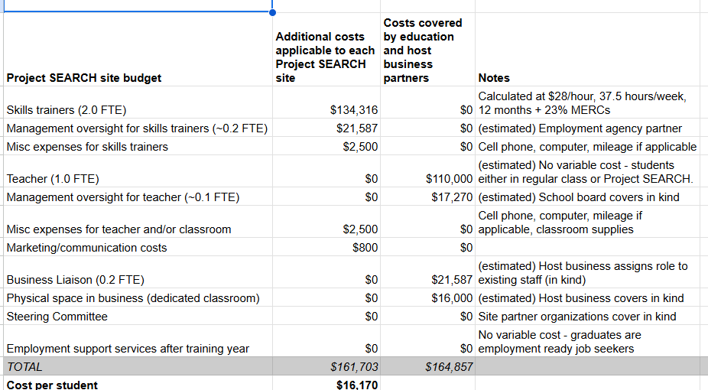
Sample site budget

Slide 21

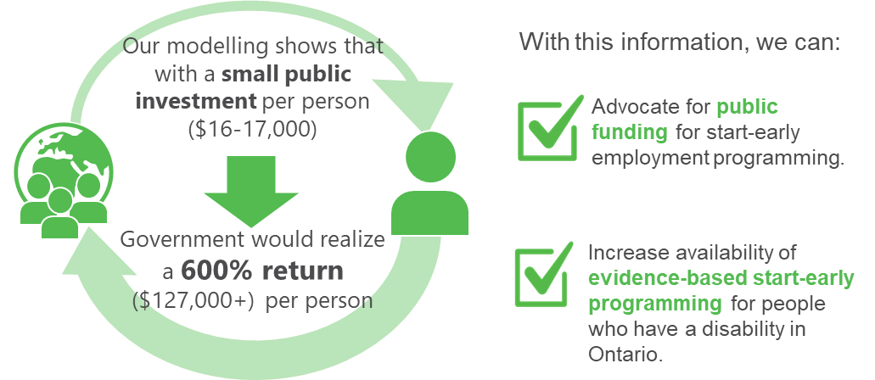
Societal impact
© Holland Bloorview Employment Pathways 2024

Slide 22

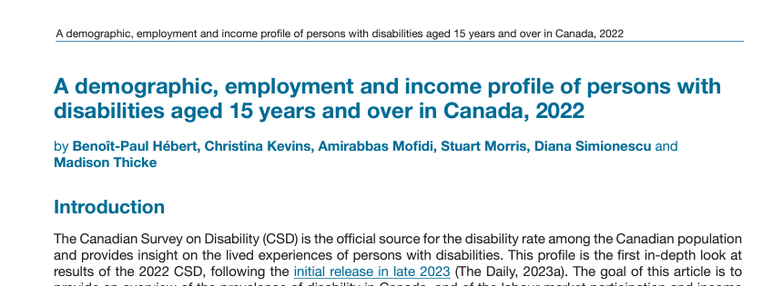

Stats - gaps in employment rate & quality
Just 40% ages 15-19 are employed
Persons with disability: employment rate 61.8% compared to 77.8%
Rate drops to ~30% - more significant disability
More than 2x as likely to be in low quality employment
Notes:
Here are some recent stats.
According to a Fraser Institute June 2024 study - young people are finding it very hard to get jobs. Just 40% of youth ages 15-19 were employed in May 2024 - the lowest rate any recent year other than during the COVID-19 pandemic.
The recent employment summary report from the 2022 Canadian Survey on Disability showed that there is a 16% gap in the employment rate of persons with disabilities compared to the general population and close to 50% for those with disabilities classified as very severe. Other reports illustrate that for people with intellectual disabilities, autism and physical disabilities with intellectual disabilities the rate of 25-30% employment is accurate.
A study by a researcher at the Institute for Work and Health found that people with disabilities are more than twice as likely to be in low quality employment - precarious or unrewarding.
These stats illustrate that youth with disabilities need focused attention and services to start to reverse these trends.

Slide 23
Stats - employment participation rates
 | This population | General population
Employment rate: Canadians with disabilities ^{[1]} Canadians with severe disabilities ^{[1,2]} Canadians with very severe disabilities ^{[1,2]} | 61.8% 54.5% 29.9% (26.1%) | 77.8%
Employment rate: Canadians with disabilities who have attained a high school diploma/certificate or less ^{[1]} | 45% | 68.1%
Youth ages 14-24 who are NEET Canadians with disabilities ^{[3]} Canadians with severe disabilities ^{[3]} | 17% 28% | 11%
© Holland Bloorview Employment Pathways 2024
[1] Hebert, et al. (2024); [2] Berrigan,et al. (2020); [3] Accessibility in Canada (2024).
Notes:
Canadians with disabilities have lower employment rates than those without disabilities – 61.8% as reported in the 2022 Canadian Survey on Disability compared to 77.8% in the general population.^{[1]}
This rate further declines as disabilities become classified as more severe
There are also training considerations. Individuals with disabilities who have attained a high school diploma/certificate or less have an employment rate of only 45% (compared to 68.1% for individuals without disabilities).^{[1]}
Youth ages 15-24 are at a particular disadvantage in today’s labour market – 17% of youth with disabilities were neither in employment nor education or training (NEET) in 2021 (percent rises to 28 amongst those with more severe disabilities) compared to 11% of all youth^{[3]}.

Slide 24
References

Slide 25
At Work, Issue 112, Spring 2023: Institute for Work & Health, Toronto. Available from https://www.iwh.on.ca/plain-language-summaries/canadians-with-disabilities-twice-as-likely-to-report-low-quality-employment-than-those-without-disabilities
Accessibility in Canada: Results from the 2022 Canadian Survey on Disability (2024-05-28). Retrieved from https://www150.statcan.gc.ca/n1/daily-quotidien/240528/dq240528b-eng.htm
Berrigan, P., Scott, C. W., & Zwicker, J. D. (2020). Employment, education, and income for Canadians with developmental disability: analysis from the 2017 Canadian survey on disability. Journal of Autism and Developmental Disorders, 53, 580-592. https://doi.org/10.1007/s10803-020-04603-3
Bowman, L. R., McDougall, C., D’Alessandro, D., Campbell, J., & Curran, C. J. (2023). The creation and implementation of an employment participation pathway model for youth with disabilities. Disability and Rehabilitation, 45(24), 4156-4164.
Bowman, L. R., McDougall, C., Doucet, R., Pooran, B., Xu, Y., & Campbell, J. (2024). Funding employment inclusion for Ontario youth with disabilities: a theoretical cost-benefit model. Frontiers in Sociology, 9, 1281088.
Bowman, L. R., McDougall, C., & Menna-Dack, D. (2024). A Justice Perspective on Ecologically-Based Employment Pathways for Individuals with Disabilities. In Intellectual Disabilities and Autism: Ethics and Practice (pp. 221-235). Cham: Springer International Publishing.
Dowler, D. L., & Walls, R. T. (2014). A Review of Supported Employment Services for People with Disabilities: Competitive Employment, Earnings, and Service Costs. The Journal of Rehabilitation, 80(1), 7.
Eisen, B. & Palacios, M. (2024, June). Recent trends in youth employment. Fraser Research Bulletin. Available from https://www.fraserinstitute.org/sites/default/files/recent-trends-in-youth-employment.pdf
Hebert, B-P., Kevins, C., Mofidi, A., Morris, S., Simionescu, D., & Thicke, M. (2024). Reports on Disability and Accessibility in Canada. A demographic, employment and income profile of persons with disabilities aged 15 years and over in Canada, 2022. Retrieved from https://www150.statcan.gc.ca/n1/pub/89-654-x/89-654-x2024001-eng.htm

Slide 26
Jetha, A., Shaw, R., Sinder, A.R., Mahood, Q., Gignac, MAM, McColl, MA, Martin Ginis, K.A., (2019). Work-focused interventions that promote the labour market transition of young adults with chronic disabling health conditions: a systematic review. Occupational and Environmental Medicine, 76(3), 189-198.
Mazzotti, V.L. et al. (2021) Secondary transition predictors of postschool success: An update to the research base. Career Development and Transition for Exceptional Individuals, 44(1), https://doi.org/10.1177/2165143420959793
Tomlinson, M. & Tholen, G. (2023) Scarring effects for young people in challenging economic times: a conceptual synthesis and future policy and research agenda, Labour and Industry, 33:3, 308-325, DOI: 10.1080/10301763.2023.2251216
Wehman, P., Schall, C., McDonough, J., Sima, A., Brooke, A., Ham, W., ... & Riehle, E. (2020). Competitive employment for transition-aged youth with significant impact from autism: A multi-site randomized clinical trial. Journal of autism and developmental disorders, 50, 1882-1897.
Wehman, P., Sima, A.P., Ketchum, J., West, M.D., Chan, F. & Luecking, R. (2014). Predictors of successful transition from school to employment for youth with disabilities. Journal of Occupational Rehabilitation, 25(2), 323-334. DOI 10.1007/s10926-014-9541-6

