Slide 1
Funding employment programs for youth with disabilities
Funding now for the labour shortage of the future
Presented by:

Slide 2
Key messages
Employment gaps & system barriers limit youth with disabilities
Sustainable, public funding for employment support needed when youth are in school - may require inter-sectoral collaboration
Benefit to youth, employers & society

Slide 3

Issue
Employment gaps & system barriers
Notes:
We’re starting with a look at some of the gaps and barriers affecting youth with disabilities.

Slide 4
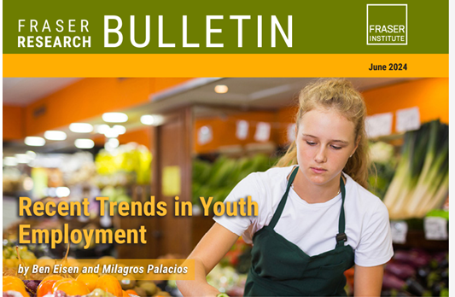
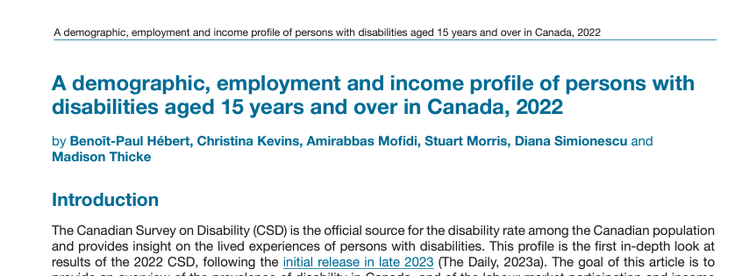
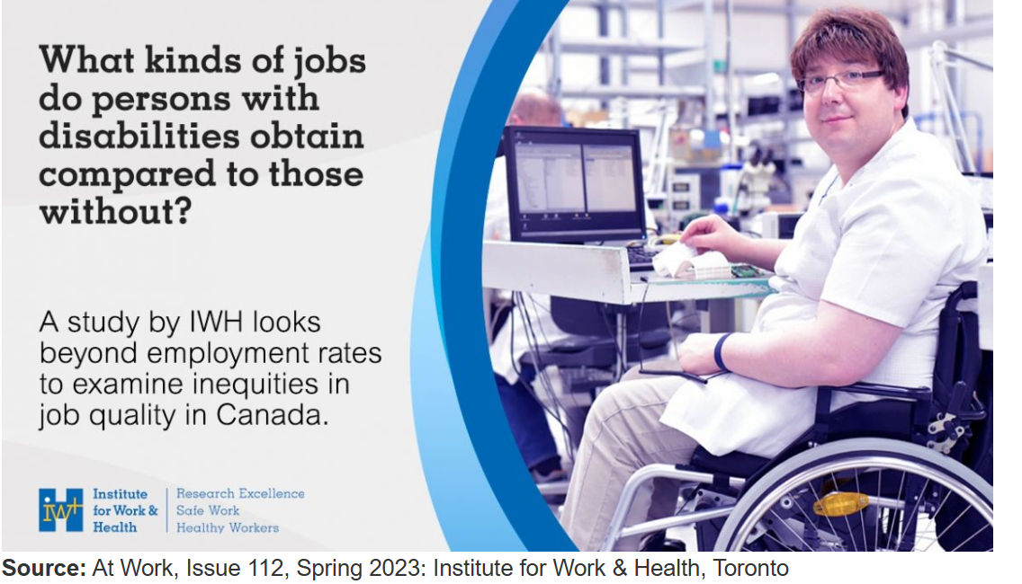
Gaps in employment rate and quality
Just 40% ages 15-19 are employed
Persons with disability: employment rate 61.8% compared to 77.8%
Rate drops to ~30% - more significant disability
More than 2x as likely to be in low quality employment
Notes:
Here are some recent stats.
According to a Fraser Institute June 2024 study - young people are finding it very hard to get jobs. Just 40% of youth ages 15-19 were employed in May 2024 - the lowest rate any recent year other than during the COVID-19 pandemic.
The recent employment summary report from the 2022 Canadian Survey on Disability showed that there is a 16% gap in the employment rate of persons with disabilities compared to the general population and close to 50% for those with disabilities classified as very severe. Other reports illustrate that for people with intellectual disabilities, autism and physical disabilities with intellectual disabilities the rate of 25-30% employment is accurate.
A study by a researcher at the Institute for Work and Health found that people with disabilities are more than twice as likely to be in low quality employment - precarious or unrewarding.
These stats illustrate that youth with disabilities need focused attention and services to start to reverse these trends.

Slide 5
Start early works
Early intervention (i.e., during high school) means:
improved postschool employment outcomes (Mazzotti et al, 2021)
greater amount of time individuals access and participate in the workforce (Wehman et al. 2020; Krahn & Chow, 2016, Caliendo & Schmidl, 2016)
Employment is a recognized social determinant of health (Raphael et al., 2020) linked with income and social inclusion
© Holland Bloorview Employment Pathways 2024
Notes:
All best practice research evidence shows us that getting work experience during high school results in greater likelihood of employment in adulthood with stronger attachment to the workforce. This is important because employment is a social determinant of health linked with income and social inclusion. All these factors impact overall health and wellbeing.

Slide 6
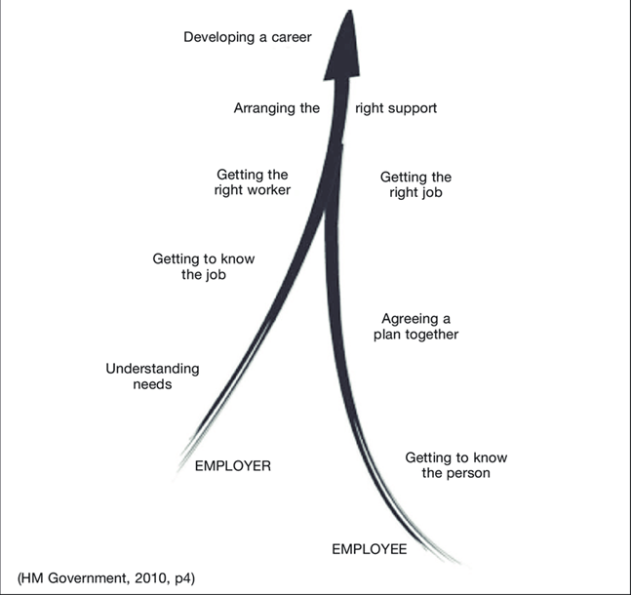
Supported employment model works
Long-standing evidence base - adults
Youth: Jetha et al (2019)
Image credit: Melling, Beyer & Kilsby (2011)
Add in information about your program if applicable!
Notes:
We also know that the supported employment model is effective. In this model an expert employment organization works with employers to understand their talent needs and with job seekers with disabilities to develop their career goals, job search plans. When a match is made the expert organization provides support initially as needed, then fades and ideally can reengage if required (such as a job change, manager change, etc.) A research student by another Institute for Work and Health researcher, Arif Jetha, illustrates the effectiveness of supported employment for youth populations specifically.

Slide 7
System barriers to typical early work experiences
Experiential learning (co-op)
Volunteering
Seasonal or part-time paid employment
Limited access for youth with support needs (coaching, personal care, etc)
No available supports to promote participation
Ineligible for provincial employment support services (student, not able to work 20+ hours)
May need more than typical “student” service
Notes:
The reality is that it is very hard for youth with disabilities to get work experience while they are in high school. There may be personal and family challenges but system barriers include limitations in availability of support personnel which can make it impossible to participate in meaningful high school co-op experiences and/or volunteering - both typical ways of building skills and experiences during high school. When youth are in school they are not eligible for provincial employment support services from organizations with expertise supporting individuals with disabilities and employers.

Slide 8
Employment supports not available to youth still in school
Employment counselling
including self-discovery, coaching re: strategies & accommodations
Work experiences &
workplace life skills training
Personal care supports, accessibility consultations
Job search (resume/interview skills building workshops)
Typically available youth supports (all ages/stages)
Available through youth employment centres and campus career centres
Personalized job search support / job development
Job coaching
Job maintenance
Examples of supports that may not be easily available while in school
Notes:
While in school youth can access only typical youth employment services such as resume/interview consultations and job posting boards but these “light touch” job search supports usually do not go far enough. Youth with disabilities often need employment counseling, supporting work experiences and workplace life skills training and personalized job development support as well as job coaching to be successful in finding work.

Slide 9

Evidence & policy recognizes start early but structures don’t support
Policy not aligned with Practice
MCCSS Journey to Belonging*
AODA Education Standards (draft)
Access Talent (2017 - not current but “start early” was 1 of 4 pillars
Image from: https://www.google.com/url?sa=i&url=https%3A%2F%2Fwww.jamesgmartin.center%2F2022%2F08%2Fthe-truth-about-student-mismatch%2F&psig=AOvVaw3wD8InjEOkA0kn5oDkDDhI&ust=1732649731414000&source=images&cd=vfe&opi=89978449&ved=0CBcQjhxqFwoTCKiCg7Cd-IkDFQAAAAAdAAAAABAE
Notes:
Ontario policy documents recognize importance of employment experiences during high school but we do not have required policy/funding alignment to make this a reality.
MCCSS’ Journey to Belonging calls for enhanced collaboration to break down service barriers and recognizes the need to improve transitions from school to work, boost employment outcomes and improve overall health and wellbeing across the lifespan.
The education standards recommendations under the Accessibility for Ontarians with Disabilities Act (AODA) target barriers and highlight the importance of transitions navigation support (recommendations 78/79) and access to experiential learning programming (recommendations 89/90) for youth with disabilities ^{[12]}. The Education Technical Sub-Committee that focused on transitions specifically called for expanded access to existing and new experiential learning programming for all students who are transitioning directly from high school to work (recommendations 65,69,71) ^{[13].}
Ontario’s former employment strategy for persons with disabilities - Access Talent - recognized “start early” as one of 4 key pillars.
https://www.ontario.ca/page/access-talent-ontarios-employment-strategy-people-disabilities#:~:text=Access%20Talent%20will%20help%20broaden,%2C%20employers%2C%20educators%20and%20governments. – no longer current but reflects policy/business perspective that start early is vital

Slide 10

Solution
Sustainable, public funding of pre-employment or employment support for students
Notes:
We need to call for -and work together to identify - sustainable, public funding mechanisms for pre-employment and employment support services for youth who are still in school.

Slide 11
Best practice: What is ‘start-early’?
?
?
?
When
What
Where
High school & post-secondary
Self discovery Experience
Risk taking
Supported reflection
Disability context/expertise
Generalize to next steps
Real-world experience
?
?
How
Who
Pre-employment & employment support programs
Equitable:
Youth, employers, society
© Holland Bloorview Employment Pathways 2024
Notes:
To explain this a bit further - we are talking about
When? Age during high school and/or post-secondary education - while people are students
What? Access to employment training programs (pre-employment) and employment support services to move into paid work
How? Program and service elements that allow for self-discovery through experiences, explicit skills training, counselling & supported reflection, job search supports

Slide 12

Impact
Stories + data
Individual, employers, society
Notes:
In this section we’ll give some examples of illustrating impact through stories and data for individuals, employers and society.

Slide 13



Impacts for individuals, employers & society
Transforming lives
Employment
Income
Social inclusion
Health & wellbeing
Building disability confidence & inclusive workplaces
Diverse workplace
Unique skills
Reduced labour market shortages
Societal cost benefit
Decrease individual lifetime social assistance costs and increase income tax
Diverse and inclusive labour force
© Holland Bloorview Employment Pathways 2024

Slide 14
Individual impact story
Individual’s support needs at start (barriers to employment)
Highlights of support/intervention provided (actions taken)
(what, when, why, where, how, how much)
Impact-individual/family
(including employment quality indicators, health/wellbeing indicators, family impacts)
Impact-employer/community
Notes:
INSERT an impact story - a youth in your community

Slide 15



Employer impact: The business case
1 in 5
Ontarians have a disability
70% of disabilities are invisible
Large consumer segment
90%
Scored average/ above average for job performance
86% scored above average for attendance
97% scored average/ above average for job safety
Companies that invested in accessible employment practices report:
↑ customer satisfaction
↑ overall employee engagement
↑ overall organizational performance
↑ safety records
↓ employee turnover
[1] https://accessibilitycanada.ca/get-help/resources/business-benefits-of-accessibility-infographic/
Notes:
There is a strong business case for disability-inclusive hiring in Ontario. As shared by Accessibility Canada, the benefits include:
Increasing your potential labour market pool. 1 in 5 Ontarians have a disability. This group represents a huge market of employees and of consumers. Understanding the needs, skills, and variability in this group can expand our Canadian human resource pool and our ability to best serve a large segment of our population.
We also know that individuals with disabilities score average or above average for attendance, safety, and job performance when given proper training, accommodation, and support.
Beyond the direct hiring and performance of any individual employee, companies that invested in their disability inclusive employment practices reported increases in major KPIs, such as client satisfaction, safety, and job retention/attendance/performance.

Slide 16

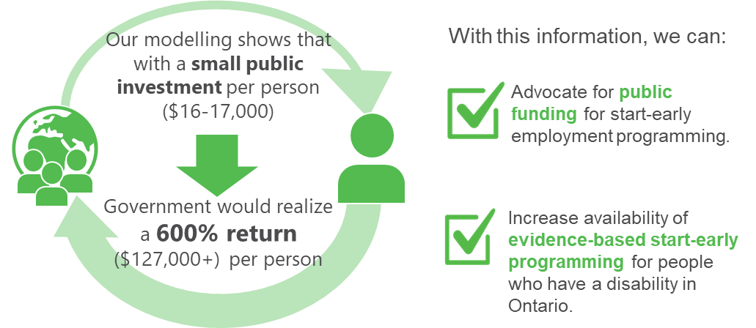
Societal impacts
© Holland Bloorview Employment Pathways 2024

Slide 17
Sources
[1] https://accessibilitycanada.ca/get-help/resources/business-benefits-of-accessibility-infographic/
[2]Hebert, B-P., Kevins, C., Mofidi, A., Morris, S., Simionescu, D., & Thicke, M. (2024). Reports on Disability and Accessibility in Canada. A demographic, employment and income profile of persons with disabilities aged 15 years and over in Canada, 2022. Retrieved from https://www150.statcan.gc.ca/n1/pub/89-654-x/89-654-x2024001-eng.htm
[3] Berrigan, P., Scott, C. W., & Zwicker, J. D. (2020). Employment, education, and income for Canadians with developmental disability: analysis from the 2017 Canadian survey on disability. Journal of Autism and Developmental Disorders, 53, 580-592. https://doi.org/10.1007/s10803-020-04603-3
[4]Accessibility in Canada: Results from the 2022 Canadian Survey on Disability (2024-05-28). Retrieved from https://www150.statcan.gc.ca/n1/daily-quotidien/240528/dq240528b-eng.htm
[5]Wehman, P., Schall, C., McDonough, J., Sima, A., Brooke, A., Ham, W., ... & Riehle, E. (2020). Competitive employment for transition-aged youth with significant impact from autism: A multi-site randomized clinical trial. Journal of autism and developmental disorders, 50, 1882-1897.
[6]Krahn, H., & Chow, A. (2016). Youth unemployment and career scarring: Social-psychological mediating effects? Canadian Journal of Sociology, 41(2), 117-138.
[7] Caliendo, M., & Schmidl, R. (2016). Youth unemployment and active labor market policies in Europe. IZA Journal of Labor Policy, 5(1), 1-30.
[8] Bowman, L. R., McDougall, C., Doucet, R., Pooran, B., Xu, Y., & Campbell, J. (2024). Funding employment inclusion for Ontario youth with disabilities: a theoretical cost-benefit model. Frontiers in Sociology, 9, 1281088.

